Slide 1

Discussion points today….
Introduction to non-tangible products and their importance in business
Strategies for successfully marketing
Best practices for managing, telecom expertise
Success and failure stories

Slide 2
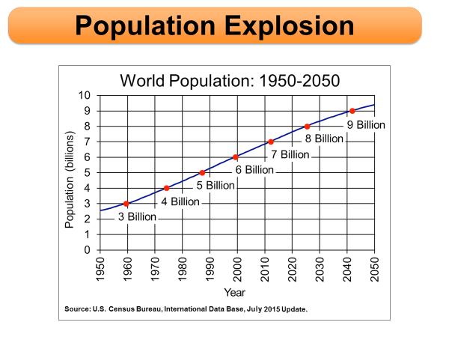

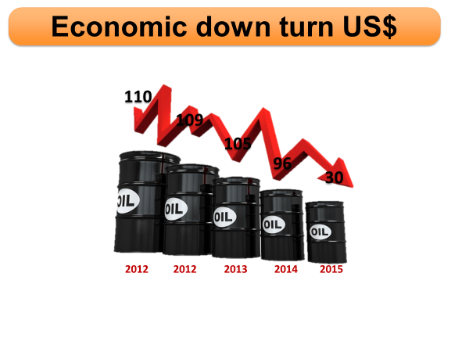

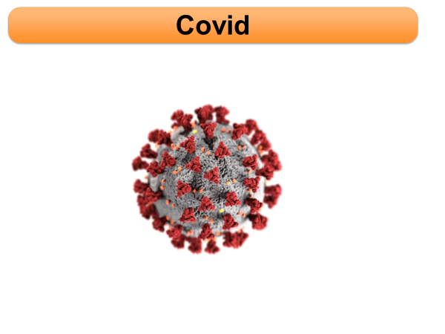
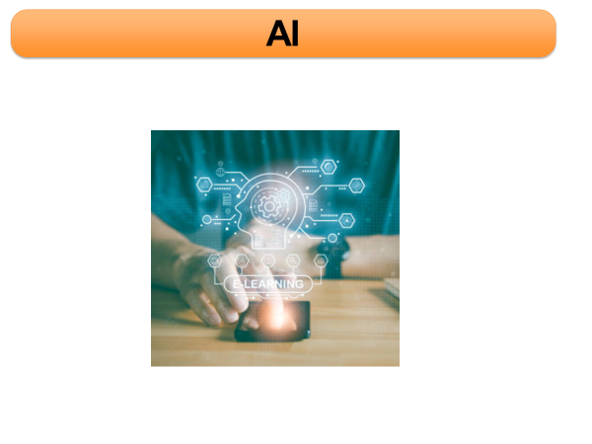
What is going around

Slide 3

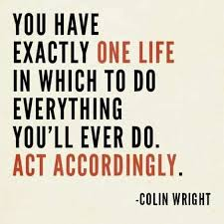

Turn it into opportunities
How?
Anticipate
Prepare
Act

Slide 4
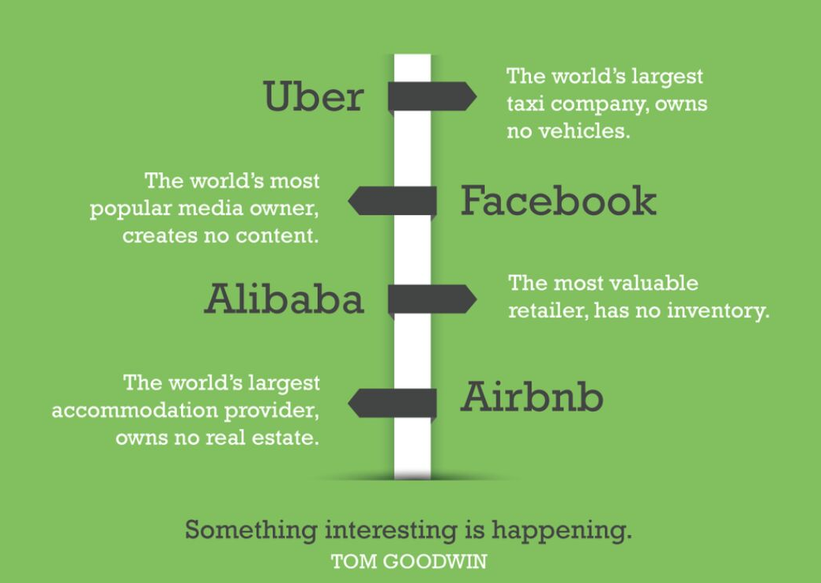
Discussion points today….
Knowledge based economy
Entrepreneurship
Professional services
New business models

Slide 5
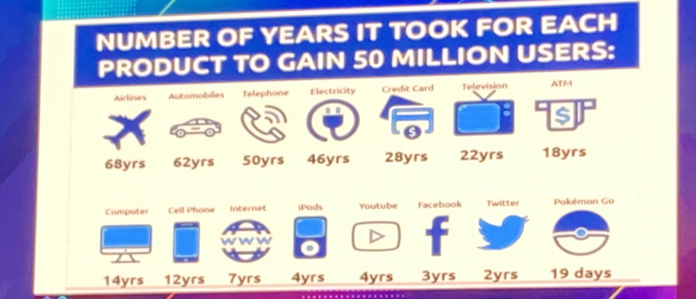
Discussion points today….

Slide 6





Non-tangible products defined
Products that cannot be tested out or inspected in advance
Buyers depend on surrogates to assess what they’re likely to get
Telecom
Insurance / Banking
Health Care
Education
Software
Communication
Every day risk
Employee
Protection
Skill Sets
Automation
Internet
Manage Portfolio
Effectiveness
Knowledge base
Efficiency
Connectivity
Legal Cost
Productivity
Learning &
unlearning
Cost Saving

Slide 7

So what is the message
Marketeers are naturally creative and have a good gut feeling of what customers need
Traditional business or digital business or non-tangible products (assumptions might be different but) same applies.

Slide 8




How we should transform
1
Data driven decision making, Big Data & Consumer Analytics
2
Partnership Management
Become the mobile advertising leader in our markets
Evolution: Database Management to consumer-centric predictive, machine learning modeling
Evolution: Managing alliances / partnerships to share adjacent business revenues, new business models
3
4
ROI, Financial & Economic Astuteness / Stewardship
Marketing Operations
Evolution: Organic growth in the current domain
Evolution: Finance / Economic intelligence, business health and handle of key decision making key parameters

Slide 9
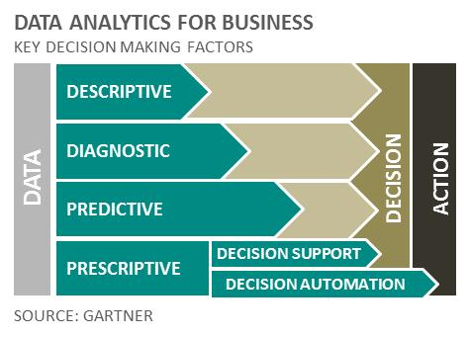
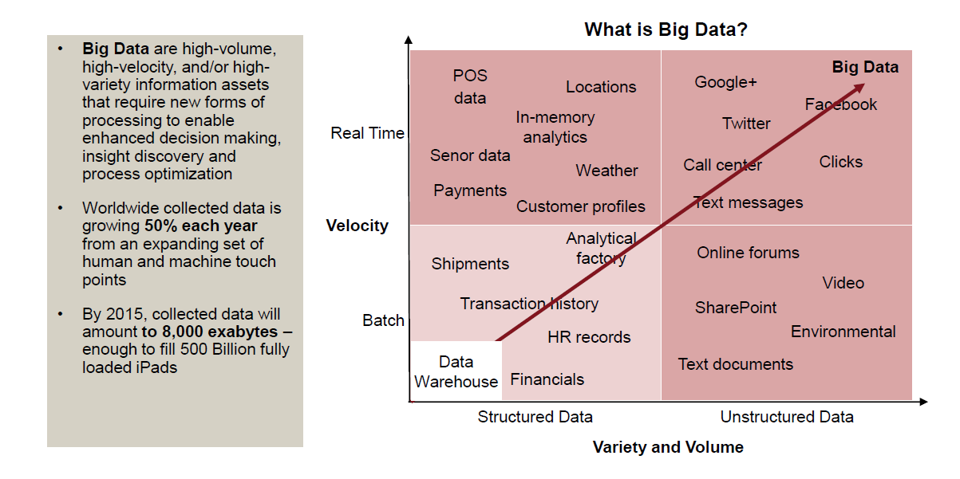

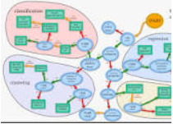
Data driven decision making
1
Become the mobile advertising leader in our markets
Permutations
Clustering
Probability
Combinations

Slide 10
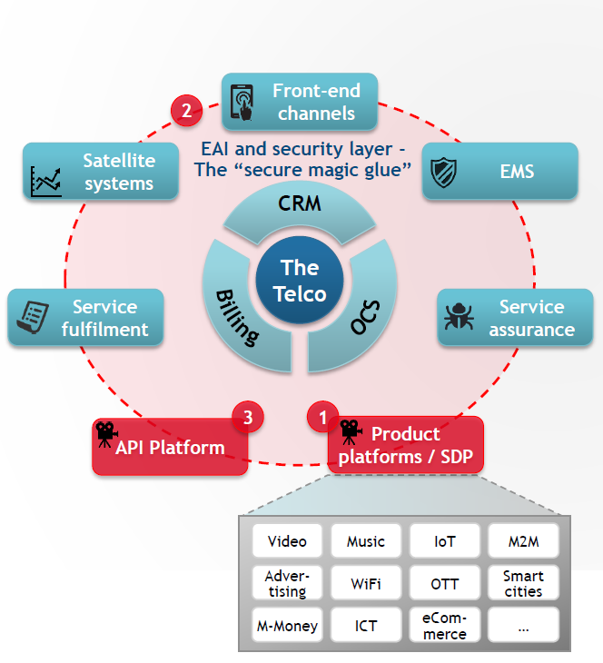
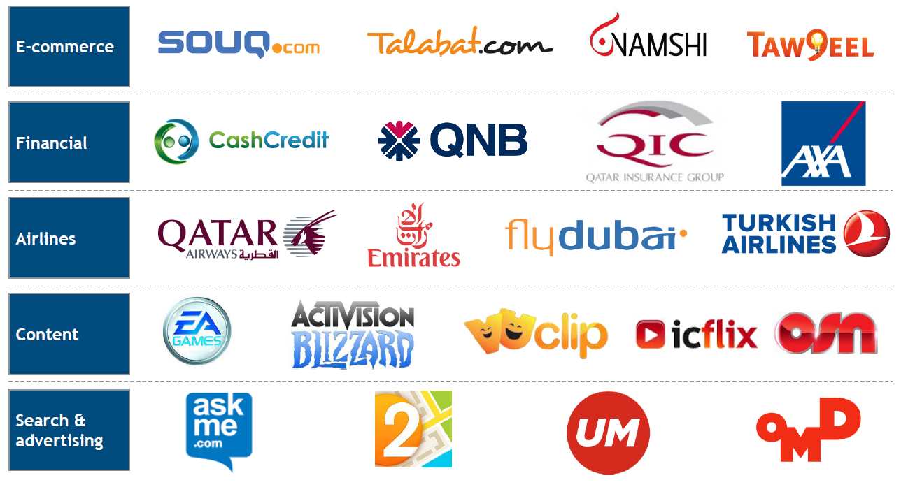
Partnerships
2
Non exhaustive
Potential players

Slide 11
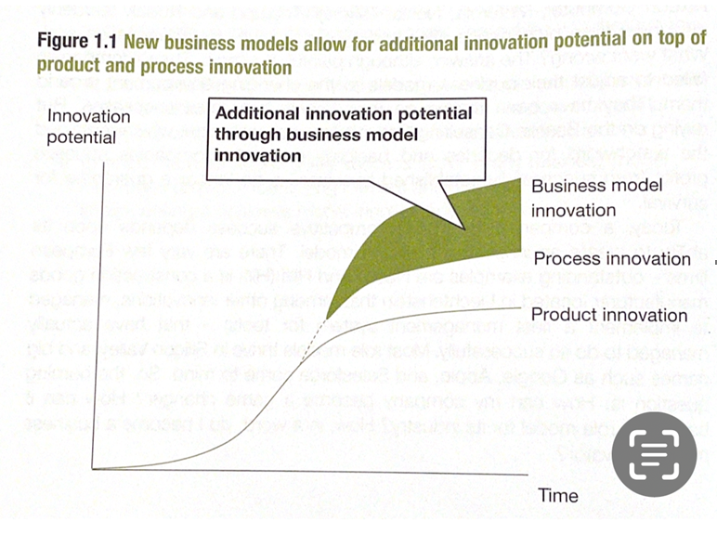
Business model change innovation potential

Slide 12






Organic growth
3
Addressing needs of personas
Each Customer is ‘scanned’ and value Potential (Increase or Decrease) assessed.
From Marketing side, we are ready with specific campaigns / programs addressing those specific opportunities.
With prioritization at Customer level to maximize efficiency (commercial & financial).
Age:
Gender:
Value Segment:
Joining date:
Price Plan:
…
Voice Local | Voice Intl | SMS Local | Data | Roaming
25 | 10 | 5 | 0 | 10
5 | 0 | 20 | 30 | 15
20 | 5 | 15 | 30 | 5
Current:
Expected
Impact ($)
2
4
3
1
5
Decliner | Stopper | Grower | Non-User | Flat
Stabilize | Revive | Learn | X Sell | Up Sell

Slide 13

Financial & Economic astuteness
4
Assets = Liabilities + Capital
Ex: RoA, RoE
Fixed assets
Current assets
Current liabilities
Long term liabilities
Revenue-Cost
Ex: Gross margin, EBITDA margins
Balance sheet
Revenue
Gross profit
Operating profit (EBITDA)
EBIT
Profit After Tax
Income statement
Cash in vs Cash out
Ex: Free cash flow
Cash Flow statement
Owner’s equity
Similar to Bank account statement
Ex: ROCE
Retention
Cash from Operating activities
Cash from Investing activities
Cash from Financing activities
Share capital
Profit for the year
Any increase in share capital
Debts

Slide 14
Financial & Economic astuteness
Total Revenue
Gross Profit
Cost of Sales
Operating Profit or EBITDA
Operational Expenditure
Cost of Sales
Free Cash Flow
Cash Taxes
Capex
Operational Expenditure
Cost of Sales
What matters most
Capital expenditure hit P&L as depreciation

Slide 15







The 3 points strategy
1. What rocks today won't rock for ever
2. Everything grows matures and dies
3. Businesses need to innovate in the same domain and continuously look at diversifying

Slide 16


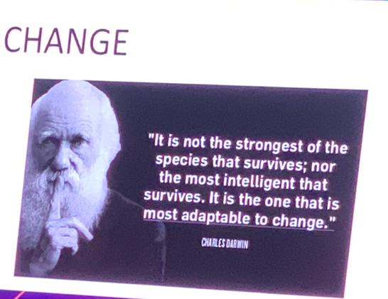
To conclude
Like Choluteca bridge in Honduras we have been rock solid, built to last, new development and the way the industry is shaping, we have to change fast …..
2023 and beyond
Very rigid and less flexible
We want to be very fluid
Sluggish time to market
Lightning fast time to market
Sometimes analysis paralysis
Fail fast and constantly try new things
Extended protocols and gates
Mind-set change

Slide 17
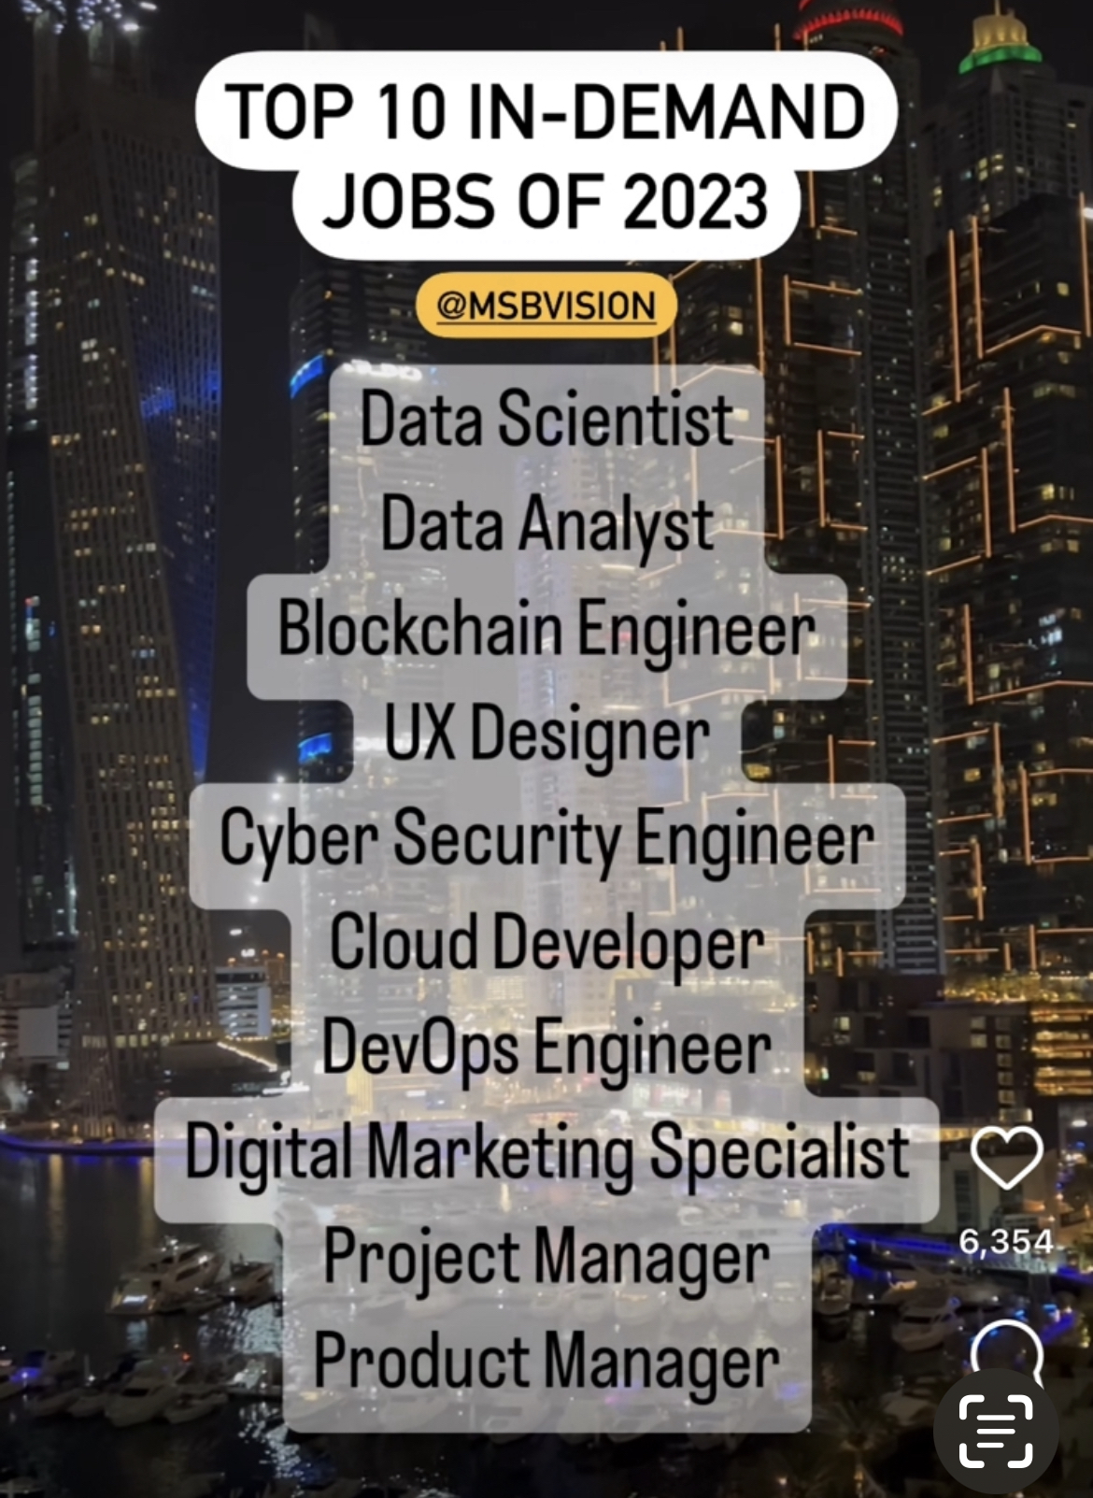
To keep a eye on

Slide 18

Discussion points today….
Introduction to non-tangible products and their importance in business
No Inventory or minimal physical assets
Selling promises – Peace of mind
Strategies for successfully marketing
Systematic and consistent proof of value for money delivered
Living up to the promises made
Best practices for managing, telecom expertise
Customized offerings or personalized, very diverse catering to Segment of 1.
Simplified Find, Buy, Use
Take away
Success and failure stories
Airbnb, Uber, FB, Amazon, App Store, iTunes, iCloud, Netflix, Google, Salesforce
Nokia, Blackberry, Kodak

Slide 19





How to transform and why
Digital
Asset light, Scalable
Processes
Future proof
Work flow
Platforms
Lower entry barrier Transportable
Our touch points
Data analytics

Slide 20
Managed Hosting of Application & Content
Value chain shift
Network Design
Network Build
Network O&M
System Integrators
… New network competencies
Network management
Shift of the original value chain
Network Management
Service
Offering
Brand & Marketing
Digital Service
Distribution
Self Care
Has expanded as a result of new products & services being introduced
Services monetization
Apps
Content Creators
Content Aggregators
OTT

Slide 21







Strategies to market non-tangible products
Demystify the product
Create Market differentiation
Have Clear USP
Non Tangible Product
Build Trust on the brand
Create Testimonials
Understand latent needs of the Market
Be Future proof

